Slide 1
Chapter 12: File System Implementation

Slide 2
Chapter 12: File System Implementation
File-System Implementation
Directory Implementation
Allocation Methods
Free-Space Management
Efficiency and Performance

Slide 3
File-System Implementation
We have system calls at the API level, but how do we implement their functions?
  On-disk and in-memory structures
Boot control block contains info needed by system to boot OS from that volume
  Needed if volume contains OS, usually first block of volume
Volume control block (superblock, master file table) contains volume details
  Total # of blocks, # of free blocks, block size, free block pointers or array
Directory structure organizes the files
  Names and inode numbers, master file table

Slide 4

File-System Implementation (Cont.)
Per-file File Control Block (FCB) contains many details about the file
  inode number, permissions, size, dates
  NFTS stores into in master file table using relational DB structures

Slide 5
In-Memory File System Structures
Mount table storing file system mounts, mount points, file system types
The following figure illustrates the necessary file system structures provided by the operating systems
Figure 12-3(a) refers to opening a file
Figure 12-3(b) refers to reading a file
Plus buffers hold data blocks from secondary storage
Open returns a file handle for subsequent use
Data from read eventually copied to specified user process memory address

Slide 6

In-Memory File System Structures

Slide 7
Partitions and Mounting
Partition can be a volume containing a file system (“cooked”) or raw – just a sequence of blocks with no file system
Boot block can point to boot volume or boot loader set of blocks that contain enough code to know how to load the kernel from the file system
  Or a boot management program for multi-os booting
Root partition contains the OS, other partitions can hold other Oses, other file systems, or be raw
  Mounted at boot time
  Other partitions can mount automatically or manually
At mount time, file system consistency checked
  Is all metadata correct?
    If not, fix it, try again
    If yes, add to mount table, allow access

Slide 8
Virtual File Systems
Virtual File Systems (VFS) on Unix provide an object-oriented way of implementing file systems
VFS allows the same system call interface (the API) to be used for different types of file systems
  Separates file-system generic operations from implementation details
  Implementation can be one of many file systems types, or network file system
    Implements vnodes which hold inodes or network file details
  Then dispatches operation to appropriate file system implementation routines

Slide 9

Virtual File Systems (Cont.)
The API is to the VFS interface, rather than any specific type of file system

Slide 10
Virtual File System Implementation
For example, Linux has four object types:
  inode, file, superblock, dentry
VFS defines set of operations on the objects that must be implemented
  Every object has a pointer to a function table
    Function table has addresses of routines to implement that function on that object
    For example:
    • int open(. . .)—Open a file
    • int close(. . .)—Close an already-open file
    • ssize t read(. . .)—Read from a file
    • ssize t write(. . .)—Write to a file
    • int mmap(. . .)—Memory-map a file

Slide 11
Directory Implementation
Linear list of file names with pointer to the data blocks
  Simple to program
  Time-consuming to execute
    Linear search time
    Could keep ordered alphabetically via linked list or use B+ tree
Hash Table – linear list with hash data structure
  Decreases directory search time
  Collisions – situations where two file names hash to the same location
  Only good if entries are fixed size, or use chained-overflow method

Slide 12
Allocation Methods - Contiguous
An allocation method refers to how disk blocks are allocated for files:
Contiguous allocation – each file occupies set of contiguous blocks
  Best performance in most cases
  Simple – only starting location (block #) and length (number of blocks) are required
  Problems include finding space for file, knowing file size, external fragmentation, need for compaction off-line (downtime) or on-line

Slide 13

Contiguous Allocation
Mapping from logical to physical
Q
LA/512
R
  Block to be accessed = Q + starting address
  Displacement into block = R

Slide 14
Extent-Based Systems
Many newer file systems (i.e., Veritas File System) use a modified contiguous allocation scheme
Extent-based file systems allocate disk blocks in extents
An extent is a contiguous block of disks
  Extents are allocated for file allocation
  A file consists of one or more extents

Slide 15
Allocation Methods - Linked
Linked allocation – each file a linked list of blocks
  File ends at nil pointer
  No external fragmentation
  Each block contains pointer to next block
  No compaction, external fragmentation
  Free space management system called when new block needed
  Improve efficiency by clustering blocks into groups but increases internal fragmentation
  Reliability can be a problem
  Locating a block can take many I/Os and disk seeks

Slide 16
Allocation Methods – Linked (Cont.)
FAT (File Allocation Table) variation
  Beginning of volume has table, indexed by block number
  Much like a linked list, but faster on disk and cacheable
  New block allocation simple

Slide 17
Linked Allocation
Each file is a linked list of disk blocks: blocks may be scattered anywhere on the disk
block =
pointer
Mapping
Q
LA/511
R
  Block to be accessed is the Qth block in the linked chain of blocks representing the file.
  Displacement into block = R + 1

Slide 18

Linked Allocation

Slide 19

File-Allocation Table

Slide 20
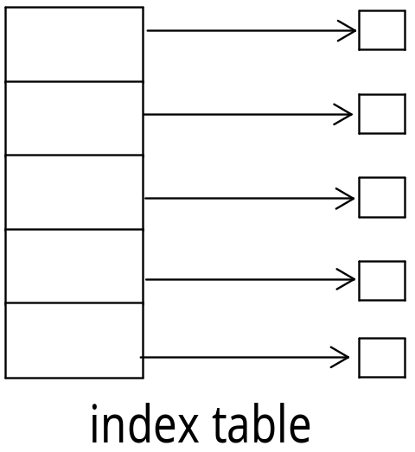
Allocation Methods - Indexed
Indexed allocation
  Each file has its own index block(s) of pointers to its data blocks
Logical view

Slide 21

Example of Indexed Allocation

Slide 22
Indexed Allocation (Cont.)
Need index table
Random access
Dynamic access without external fragmentation, but have overhead of index block
Mapping from logical to physical in a file of maximum size of 256K bytes and block size of 512 bytes. We need only 1 block for index table
Q
LA/512
R
Q = displacement into index table
R = displacement into block

Slide 23
Indexed Allocation – Mapping (Cont.)
Mapping from logical to physical in a file of unbounded length (block size of 512 words)
Linked scheme – Link blocks of index table (no limit on size)
Q₁
LA / (512 x 511)
R₁
  Q₁ = block of index table
  R₁ is used as follows:
Q₂
R₁ / 512
R₂
  Q₂ = displacement into block of index table
  R₂ displacement into block of file:

Slide 24
Indexed Allocation – Mapping (Cont.)
Two-level index (4K blocks could store 1,024 four-byte pointers in outer index -> 1,048,567 data blocks and file size of up to 4GB)
Q₁
LA / (512 x 512)
R₁
  Q₁ = displacement into outer-index
  R₁ is used as follows:
Q₂
R₁ / 512
R₂
  Q₂ = displacement into block of index table
  R₂ displacement into block of file:

Slide 25
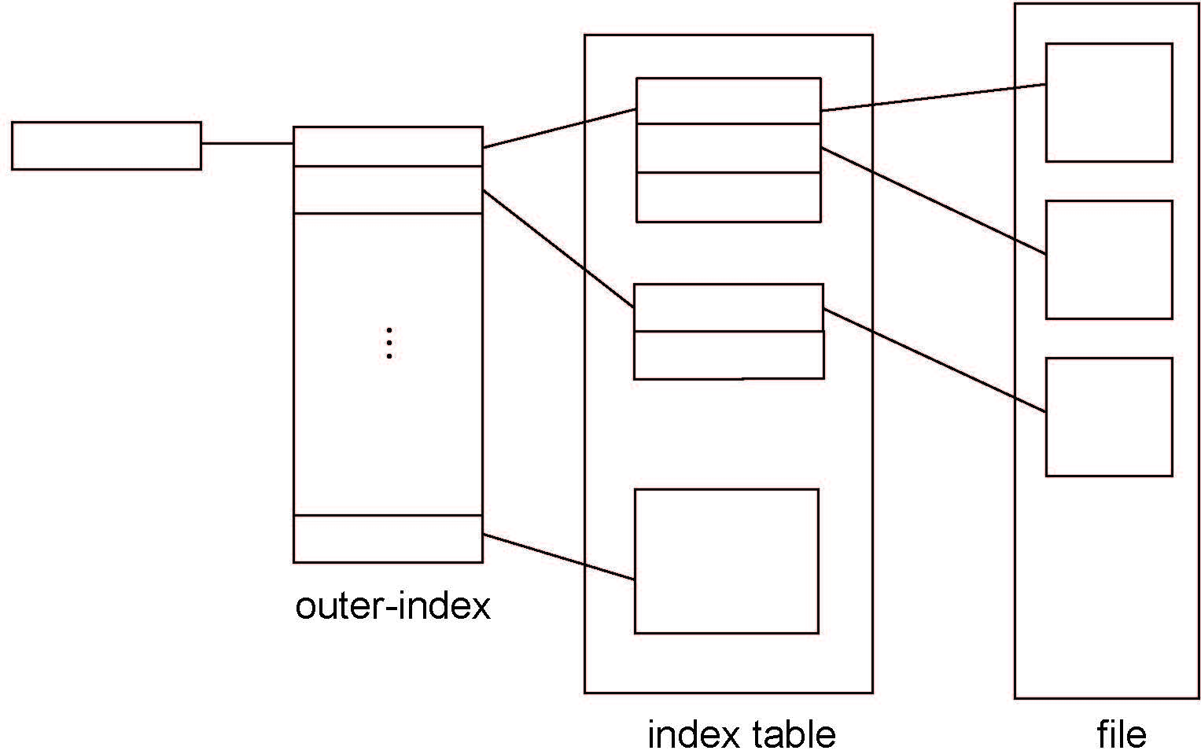
Indexed Allocation – Mapping (Cont.)

Slide 26

Combined Scheme: UNIX UFS
4K bytes per block, 32-bit addresses
More index blocks than can be addressed with 32-bit file pointer

Slide 27
Performance
Best method depends on file access type
  Contiguous great for sequential and random
Linked good for sequential, not random
Declare access type at creation -> select either contiguous or linked
Indexed more complex
  Single block access could require 2 index block reads then data block read
  Clustering can help improve throughput, reduce CPU overhead

Slide 28
Performance (Cont.)
Adding instructions to the execution path to save one disk I/O is reasonable
  Intel Core i7 Extreme Edition 990x (2011) at 3.46Ghz = 159,000 MIPS
    http://en.wikipedia.org/wiki/Instructions_per_second
  Typical disk drive at 250 I/Os per second
    159,000 MIPS / 250 = 630 million instructions during one disk I/O
  Fast SSD drives provide 60,000 IOPS
    159,000 MIPS / 60,000 = 2.65 millions instructions during one disk I/O

Slide 29
Free-Space Management
File system maintains free-space list to track available blocks/clusters
  (Using term “block” for simplicity)
Bit vector or bit map (n blocks)
0
1
2
n-1
…
1 ⇒ block[i] free
0 ⇒ block[i] occupied
bit[i] =

Block number calculation
(number of bits per word) *
(number of 0-value words) +
offset of first 1 bit
CPUs have instructions to return offset within word of first “1” bit

Slide 30
Free-Space Management (Cont.)
Bit map requires extra space
  Example:
block size = 4KB = 2¹² bytes
disk size = 2⁴⁰ bytes (1 terabyte)
n = 2⁴⁰/2¹² = 2²⁸ bits (or 32MB)
if clusters of 4 blocks -> 8MB of memory
Easy to get contiguous files

Slide 31

Linked Free Space List on Disk
Linked list (free list)
  Cannot get contiguous space easily
  No waste of space
  No need to traverse the entire list (if # free blocks recorded)

Slide 32
Free-Space Management (Cont.)
Grouping
  Modify linked list to store address of next n-1 free blocks in first free block, plus a pointer to next block that contains free-block-pointers (like this one)
Counting
  Because space is frequently contiguously used and freed, with contiguous-allocation allocation, extents, or clustering
    Keep address of first free block and count of following free blocks
    Free space list then has entries containing addresses and counts

Slide 33
Free-Space Management (Cont.)
Space Maps
  Used in ZFS
  Consider meta-data I/O on very large file systems
    Full data structures like bit maps couldn’t fit in memory -> thousands of I/Os
  Divides device space into metaslab units and manages metaslabs
    Given volume can contain hundreds of metaslabs
  Each metaslab has associated space map
    Uses counting algorithm
  But records to log file rather than file system
    Log of all block activity, in time order, in counting format
  Metaslab activity -> load space map into memory in balanced-tree structure, indexed by offset
    Replay log into that structure
    Combine contiguous free blocks into single entry

Slide 34
Efficiency and Performance
Efficiency dependent on:
  Disk allocation and directory algorithms
  Types of data kept in file’s directory entry
  Pre-allocation or as-needed allocation of metadata structures
  Fixed-size or varying-size data structures

Slide 35
Efficiency and Performance (Cont.)
Performance
  Keeping data and metadata close together
  Buffer cache – separate section of main memory for frequently used blocks
  Synchronous writes sometimes requested by apps or needed by OS
    No buffering / caching – writes must hit disk before acknowledgement
    Asynchronous writes more common, buffer-able, faster
  Free-behind and read-ahead – techniques to optimize sequential access
  Reads frequently slower than writes

Slide 36
End of Chapter 12

